Slide 1
Learning Processes (PART 2)

Slide 2
Chapter Organization
Learning rules
Error-correction learning
Memory-based learning
Hebbian learning
Competetive learning
Boltzman learning
Learning paradigms
Credit-assignment problem
Learning with a teacher
Learning without a teacher
Learning tasks, memory, and adaptation
Probabilistic and statistical aspects of learning (omitted)

Slide 3
Credit-Assignment Problem
It is the problem of assigning credit or blame for overall outcomes to each of the internal decisions made by the learning machine and which contributed to those outcomes.
Sometimes called loading problem
Dependence of outcomes on internal decisions are mediated by a sequence of actions
1. Assignment of credit for outcomes to actions (temporal credit-assignment problem in that it involves the instants of time when the actions that deserve credit were actually taken.)
2. Assignment of credit for actions to internal decisions (structural credit-assignment problem in that it involves assigning credit to the internal structures of actions generated by the system.)

Slide 4
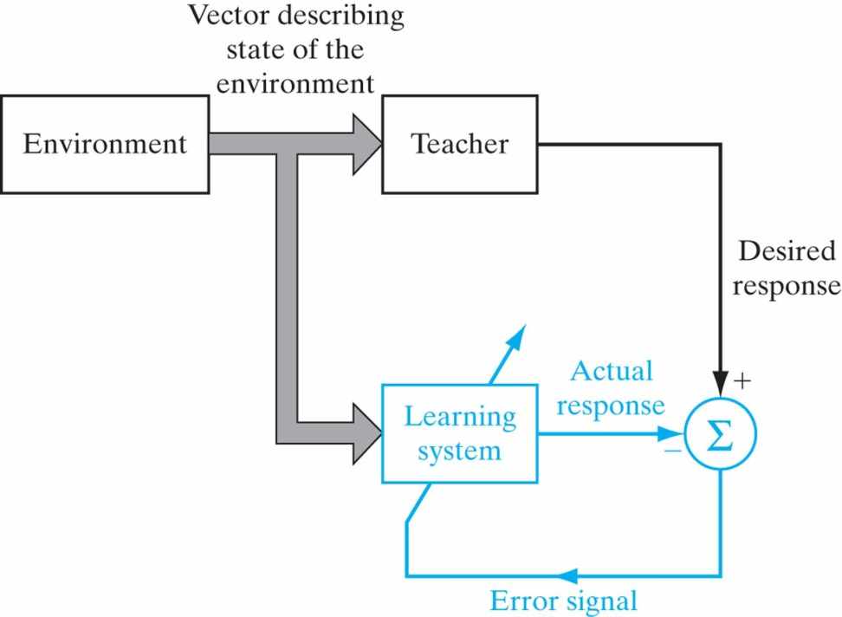
Learning with a Teacher
Also called supervised learning
The teacher has knowledge of the environment
Error-performance surface

Slide 5
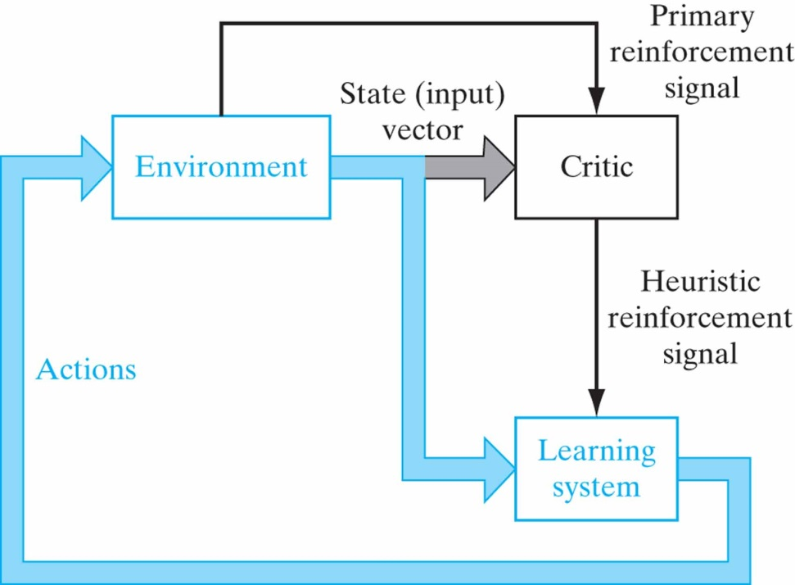
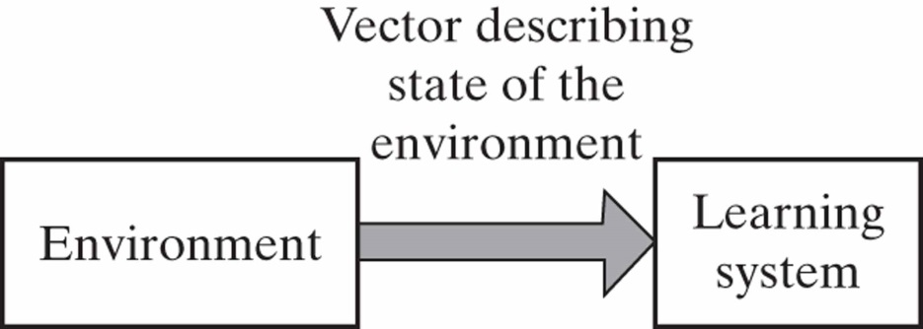
Learning without a Teacher
No labeled examples available of the function to be learned.
Reinforcement learning
Unsupervised learning

Slide 6
Reinforcement learning
The learning of input-output mapping is performed through continued interaction with the environment in order to minimize a scalar index of performance.

Slide 7
Reinforcement Learning
Delayed reinforcement, which means that the system observes a temporal sequence of stimuli.
Difficult to perform for two reasons:
There is no teacher to provide a desired response at each step of the learning process.
The delay incurred in the generation of the primary reinforcement signal implies that the machine must solve a temporal credit assignment problem.
Reinforcement learning is closely related to dynamic programming.

Slide 8

Unsupervised Learning
There is no external teacher or critic to oversee the learning process.
The provision is made for a task independent measure of the quality of representation that the network is required to learn.

Slide 9
Chapter Organization
Learning rules
Error-correction learning
Memory-based learning
Hebbian learning
Competetive learning
Boltzman learning
Learning paradigms
Credit-assignment problem
Learning with a teacher
Learning without a teacher
Learning tasks, memory, and adaptation
Probabilistic and statistical aspects of learning (omitted)

Slide 10
Issues of Learning Tasks Pattern Association
An associative memory is a brainlike distributed memory that learns by association.
Autoassociation: A neural network is required to store a set of patterns by repeatedly presenting them to the network. When the network is presented a partial description of an original pattern stored in it, the task is to retrieve that particular pattern.
Heteroassociation: It differs from autoassociation in that an arbitary set of input patterns is paired with another arbitary set of output patterns.

Slide 11
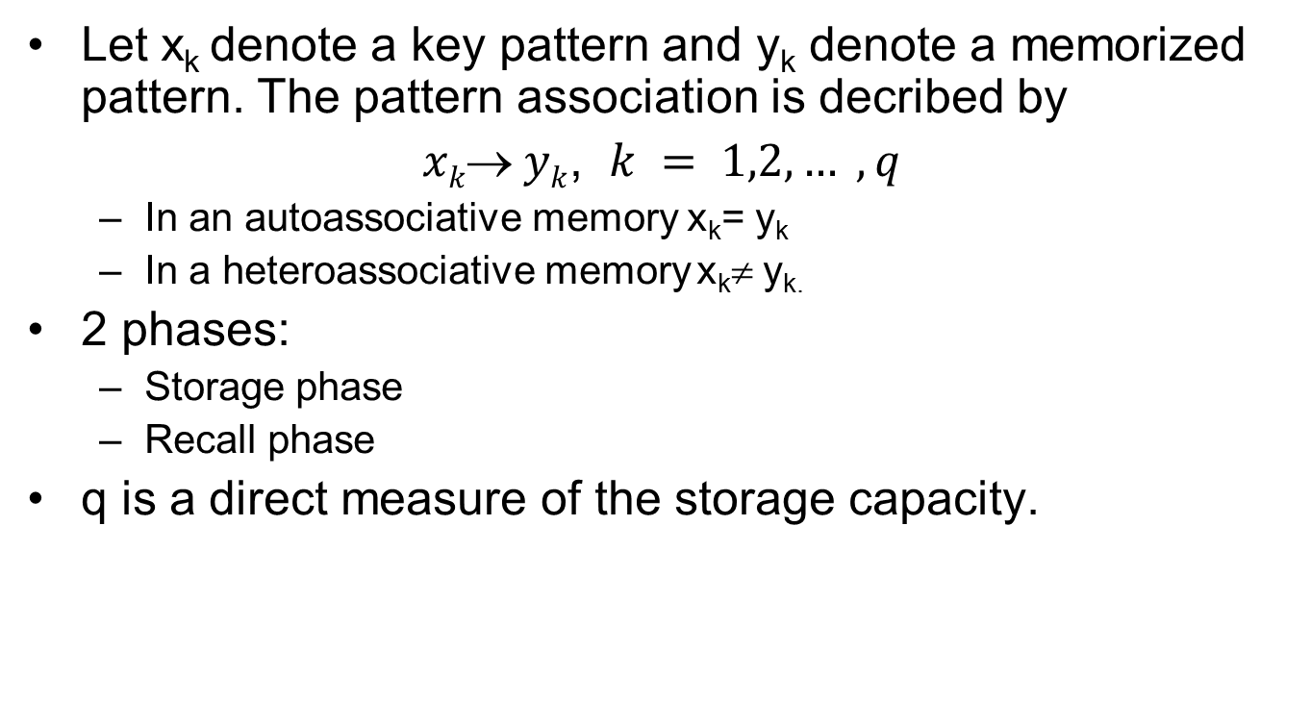
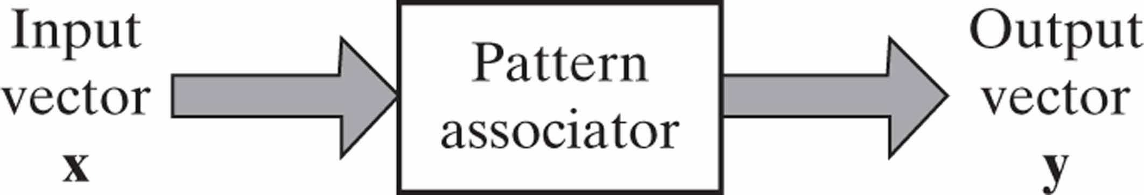
Issues of Learning Tasks Pattern Association

Slide 12
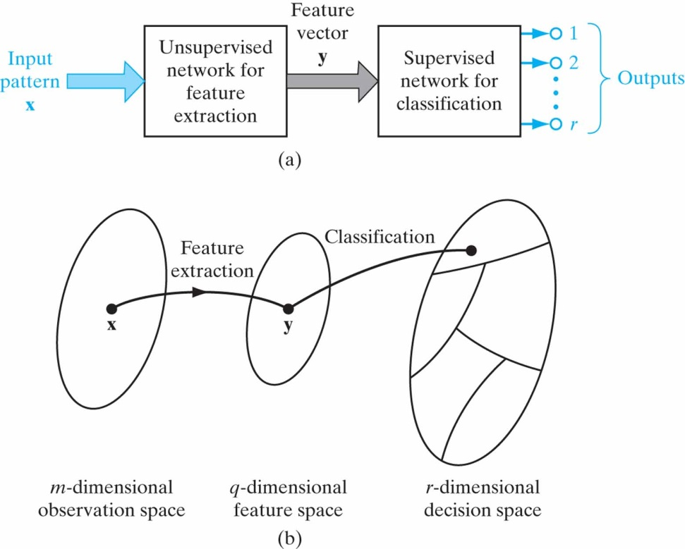
Issues of Learning Tasks Pattern Recognition
The process whereby a received pattern/signal is assigned to one of a prescribed number of classes
ANN pattern recognition is statistical;
patterns are represented as points in a multidimensional decision space
This space is divided into regions each representing a class
ANN pattern recognisers can be in one of 2 forms
A feature extractor and a classifier (a)
A single multilayer feedforward network

Slide 13
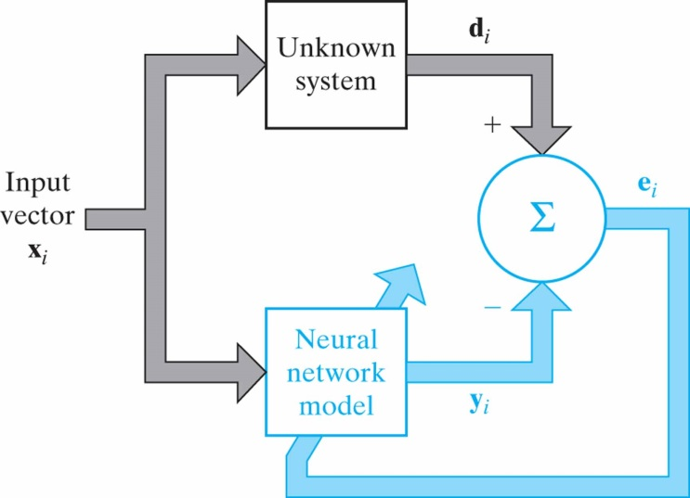
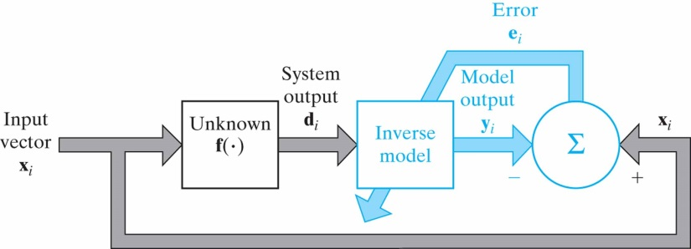
Issues of Learning Tasks Function Approximation
Consider a nonlinear input-output mapping
d =f(x)
The vector x is the input and the vector d is the output.
The function f(.) is assumed to be unknown.
The requirement is to design a neural network that approximates function f(.) .
⏐⏐F(x)-f(x)⏐⏐< ε for all x
System identification
Inverse system

Slide 14
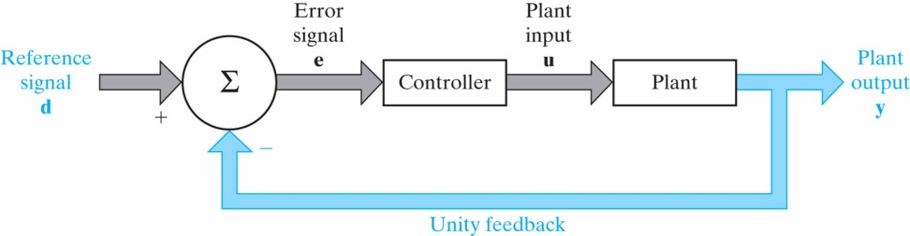
Issues of Learning Tasks Control
Control: The controller has to invert the plant’s input-output behavior.
Indirect learning
Direct learning

Slide 15
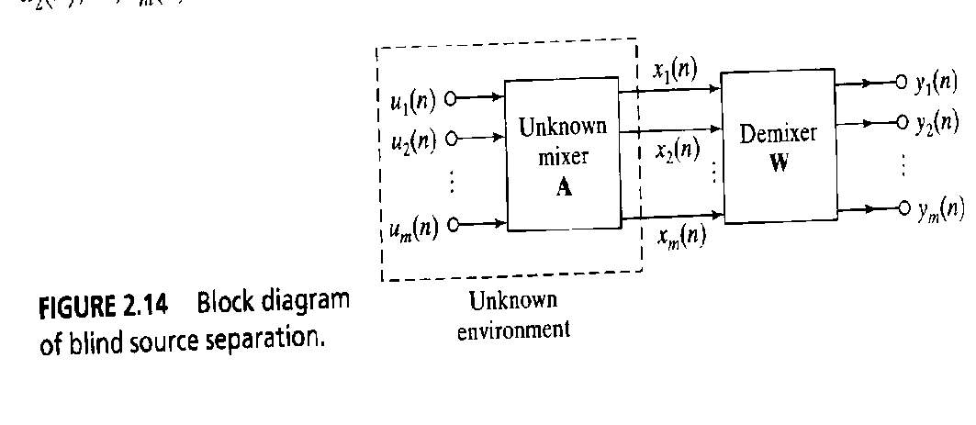
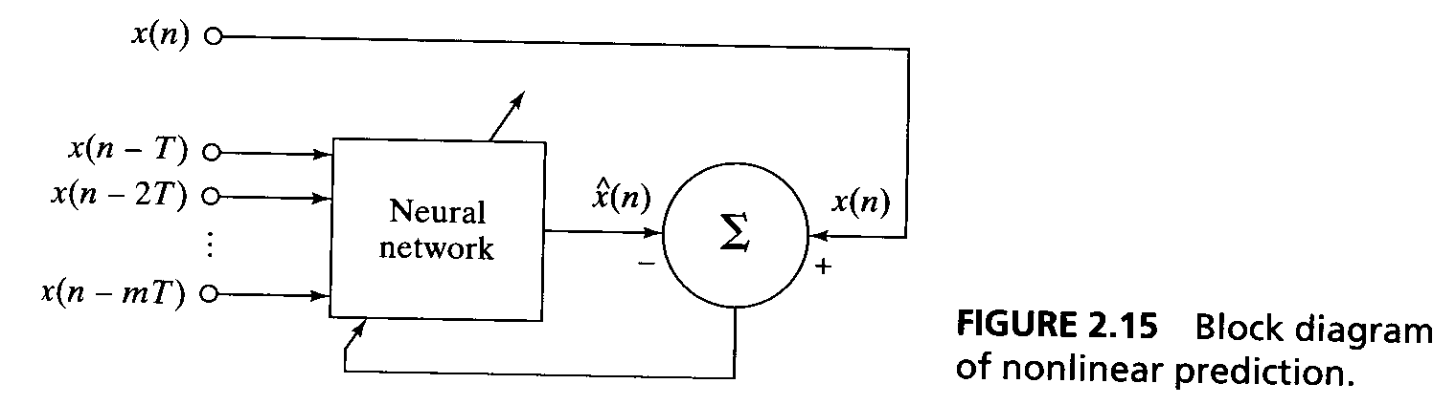
Issues of Learning Tasks Filtering
A filter extracts information about a prescribed quantity of interest from a set of noisy data. A filter can be used for
Filtering
Smoothing
Prediction
Coctail party problem -> blind signal separation

Slide 16
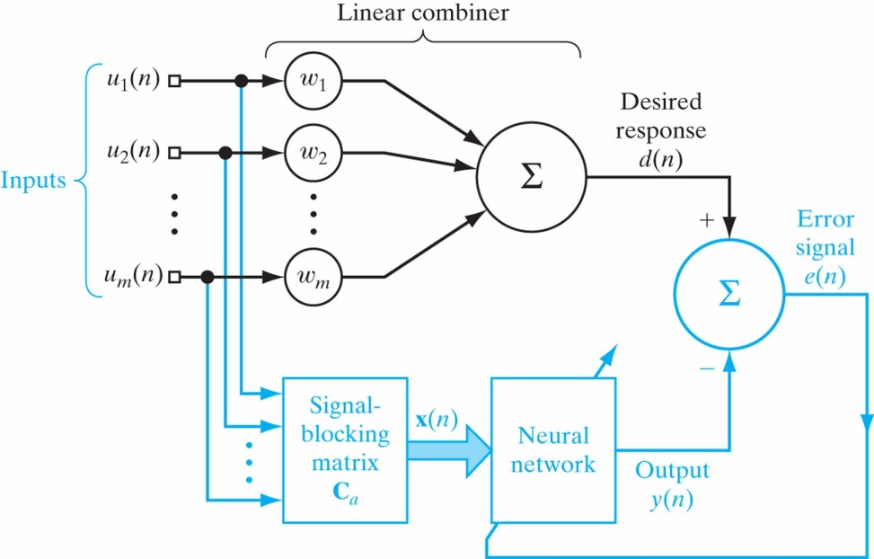
Issues of Learning Tasks Beamforming
A spatial form of filtering
Used to distinguish between a target signal and background noise

Slide 17
Memory and Adaptation
Learning tasks (particularly pattern association) leads us to think about memory
In neurobiology, memory refers to relatively enduring neural alterations induced by an organism’s interaction with its environment
Memory and learning are intricately connected
When something is learned, it is stored in brain
Space is one dimension of learning process and time is the other
Biological species (insects, humans, etc.) are capable of representing the temporal structure in an experience
Hence, they adapt their behavior to the temporal structure of an event
In a stationary environment, after training, ANN’s synaptic weights can be froze
In a non-stationary environment this is not an option (continuous learning)
Considering processes as pseudo-stationary is useful in many cases

